Slide 1
Representations
Nisheeth
1st February 2018

Slide 2
Course trajectory
Foundations
Perception
Categorization
Memory
Behavior
Motor
Mental
Speech

Slide 3

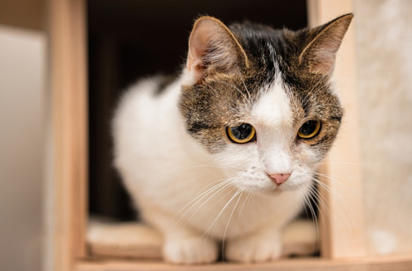
Categorization
Ordering experience into distinct sets

Slide 4
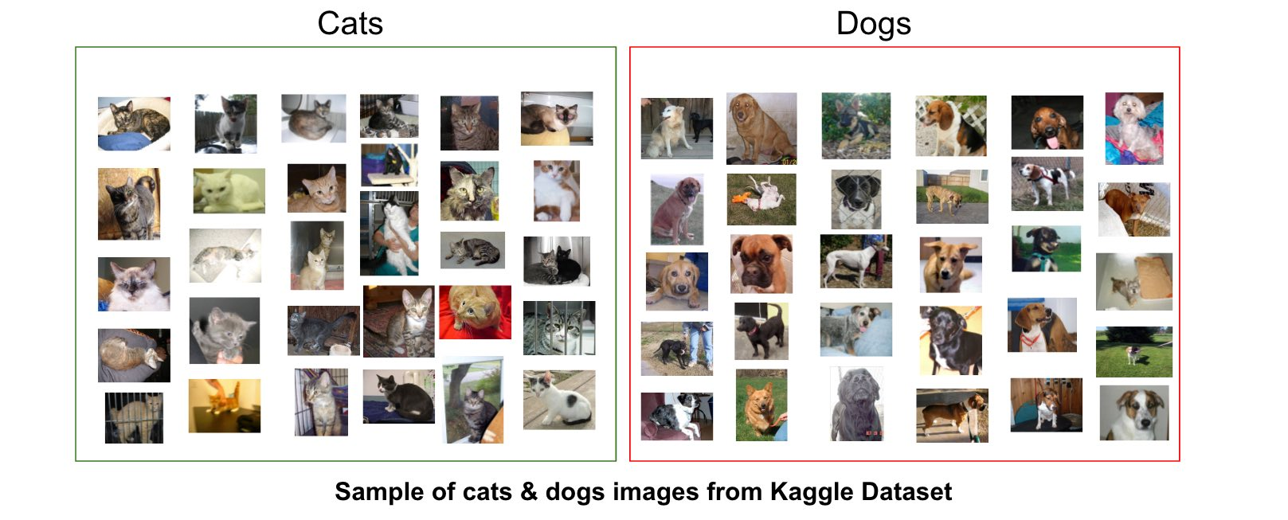
Can solve this using machine learning?
That’s a major thrust of modern ML

Slide 5
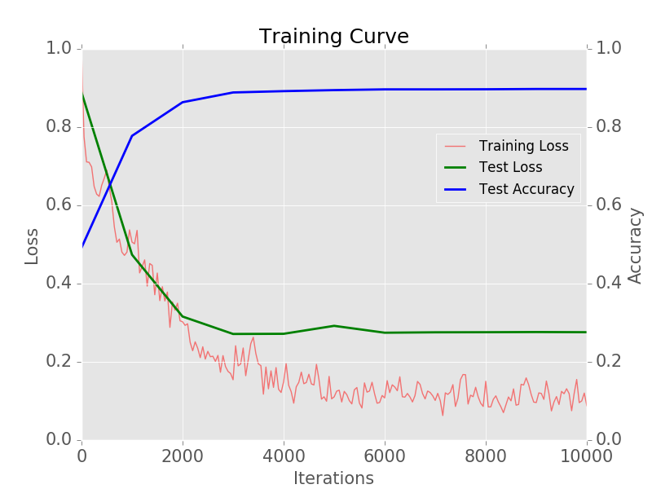
Similarity-based approaches are data-intensive
http://adilmoujahid.com/posts/2016/06/introduction-deep-learning-python-caffe/

Slide 6
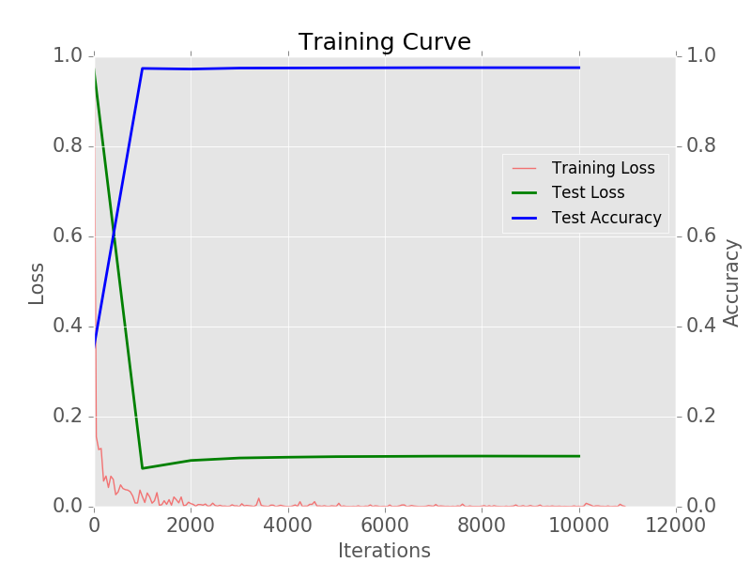
Even assuming transfer learning

Slide 7
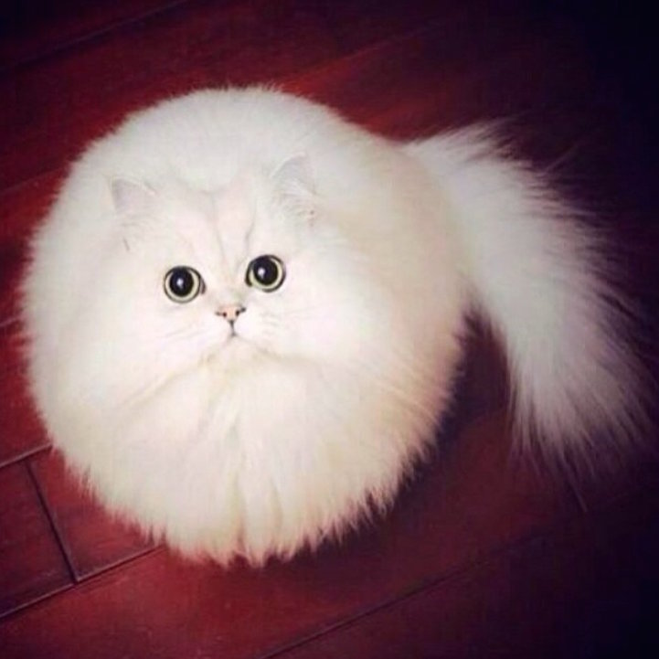

Human categorization is much more frugal
My 3 year old knows which is a cat and which is a dog

Slide 8
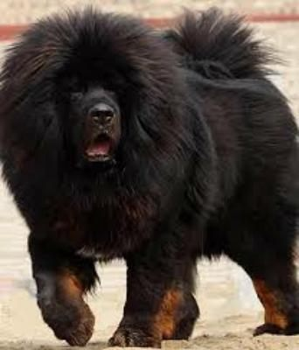
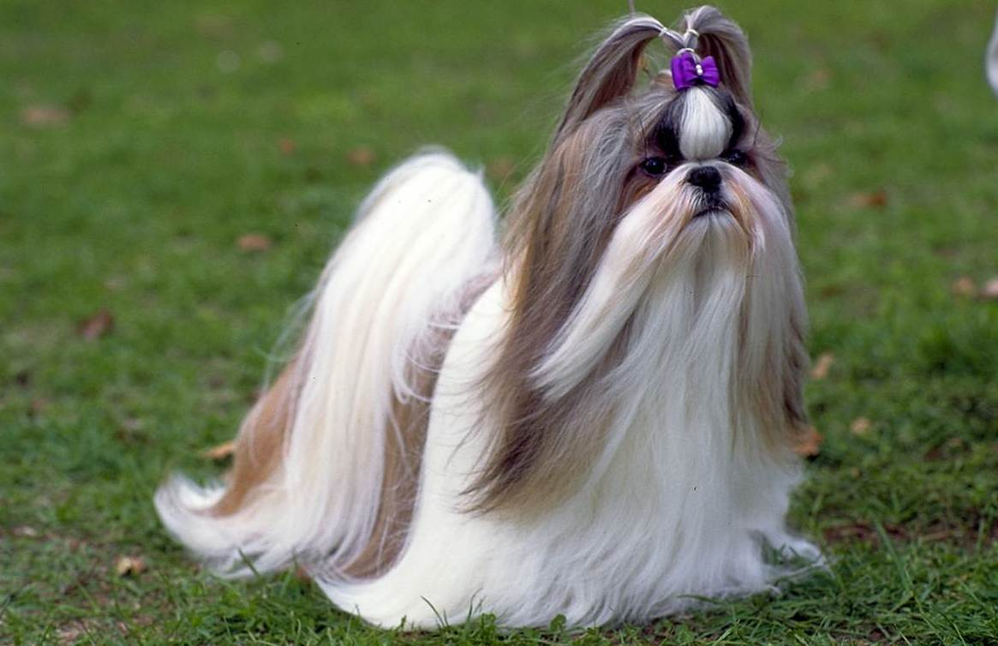
And resilient to visual differences

Slide 9


Similarity is not the only source of category information
Same category?
Different category?

Slide 10
Representation
“any notation or sign or set of symbols which ‘re-presents’ something to us…that is, stands for something in the absence of that thing”
objects of the external world (things)
objects of the internal world (ideas)
The “what” and “how” of representation is critical to most core issues in cognitive psychology
implies some storage of information
key problem: what is stored?
nature of representation can be revealed through performance, but there are limitations
Notes:
This slide depicts what represntations are for.
They are cool

Slide 11
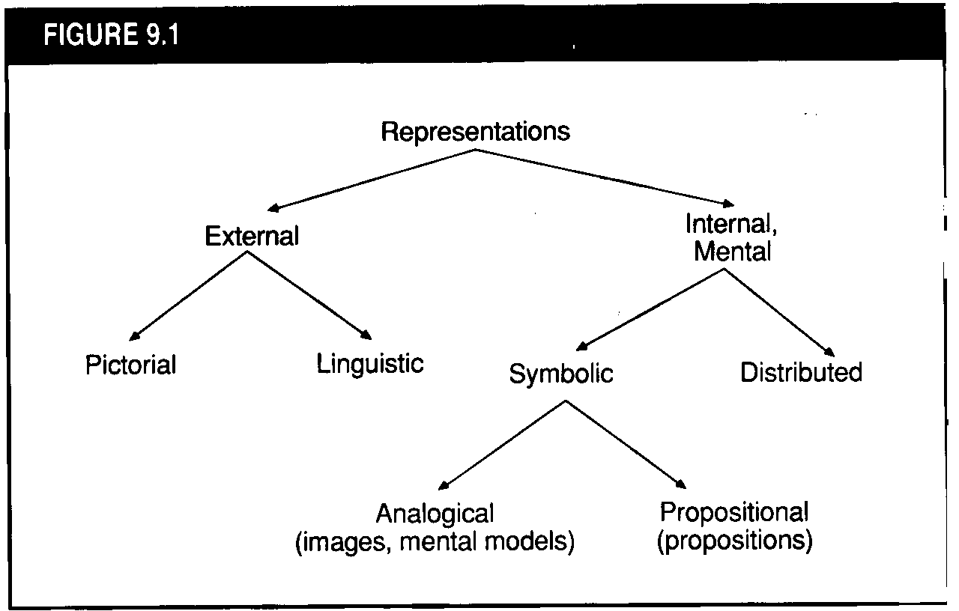
Types of Representations
maps
written language
Notes:
Eysenck’s rubric for separating out representations.

Slide 12
Representations: Another classification
Perceptually-based representations
Imagery (encodes visual+spatial structure)
visual (object-based)
spatial
Linear Orderings (encodes sequence)
Meaning-based representations (encode what is significant about an event)
Propositions (code relations ‘linguistically’)
Schemas (large, complex units of knowledge)
event schemas (scripts)
object schemas (concepts)
attributes
prototypes

Slide 13
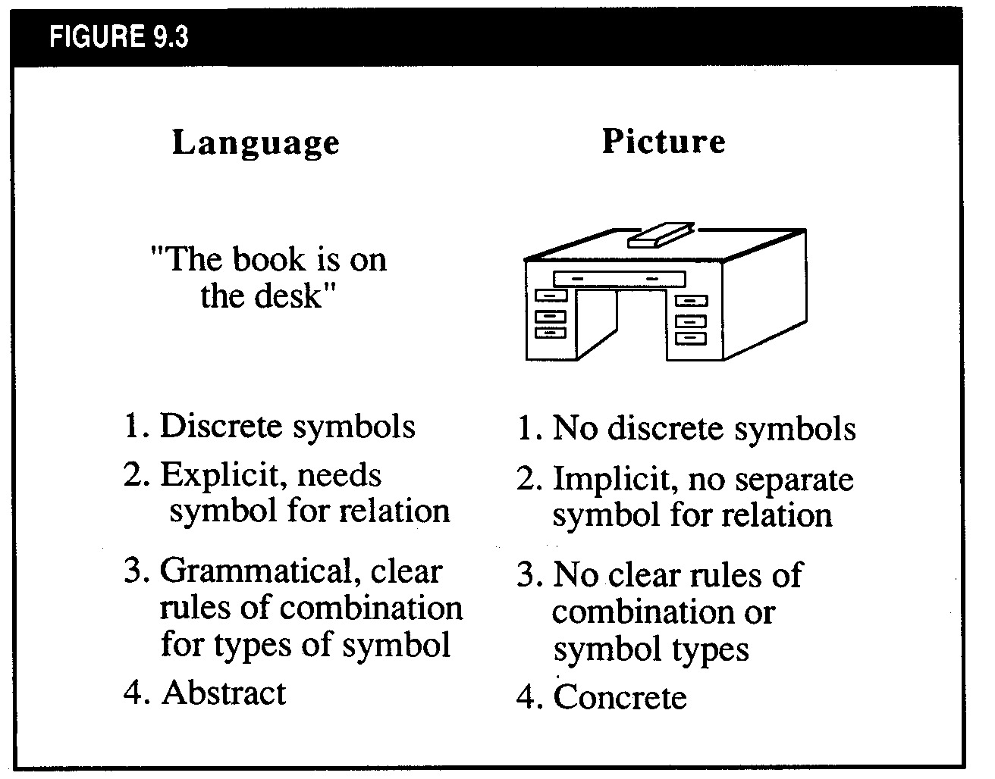

Slide 14
Images vs. Propositions
Are images really different from propositions?
YES (Paivio dual-coding theory)
NO (Pylyshyn, Anderson & Bower)
Does imagery have any functional significance?
What is the relationship between perception and imagery?

Slide 15
Memory for Visual Images
Although people are generally good at remembering the general ‘gist’ (meaning) of pictures, memory for picture details is relatively poor
Representative studies:
Mandler & Ritchey (1977): study classroom pictures, present with distractors (next slide)
Nickerson & Adams (1979): people virtually at chance in reproducing the correct configuration of a penny
Conclusion: meaning-based representations ARE really different from perceptually-based representations

Slide 16
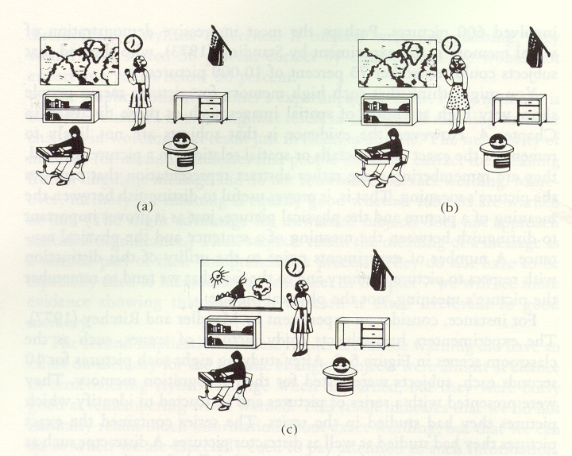

Slide 17
Paivio’s Dual-Coding Theory
Two basic coding systems: verbal and nonverbal
Each is specialized for encoding, storing, organizing and retrieving information
Each system consists of sensorimotor subsystems
Basic representational units: logogens and imagens
Systems interconnected by ‘referential links’

Slide 18
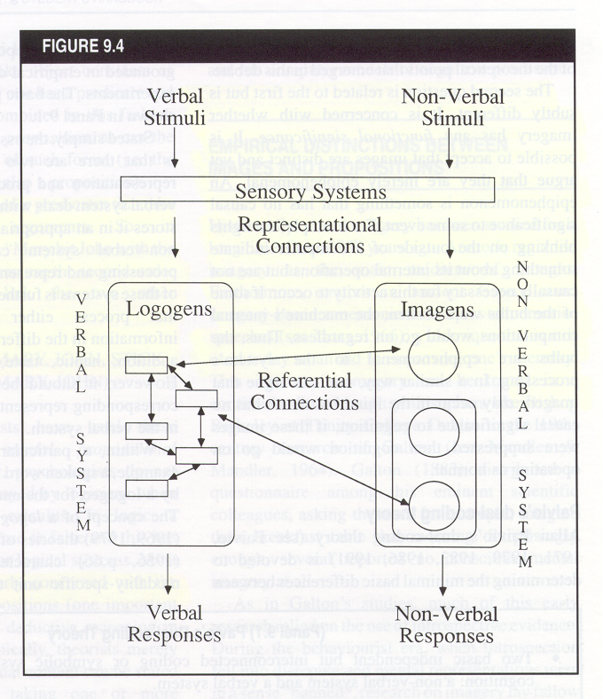
Paivio’s Dual-Coding Theory

Slide 19
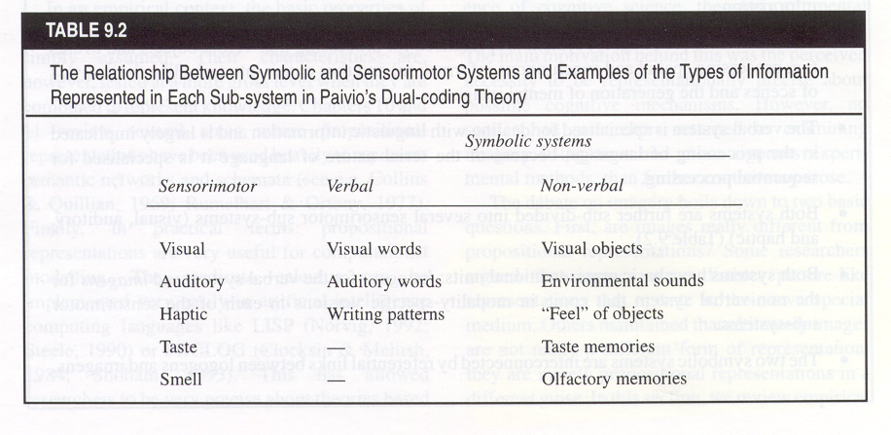

Slide 20
Evidence for and against dual-coding theory
FOR
Free recall of pictures > words
Concrete words > abstract words
Free recall of words encoded with imagery instructions > pronunciation
Spatial interference effects (Baddeley et al., Brooks)
Hemispheric differences in abstract-concrete word recognition
AGAINST
Interactive imagery instructions enhance cued-recall, but separate-imagery instructions do not (enhance relational organization)
Little evidence for cognitive mechanisms of imagery (but see next slides; this may be changing)

Slide 21
Motor imagery task produces more congruent activation (compared to actual movement) in motor cortex after practice
Lacourse, et al., 2005, Neuroimage, 27, 505-519.
Notes:
A sequential button press task was performed using the right hand while it rested on a four-key response pad (Neuroscan, Inc.) during two test sessions and five physical practice sessions over 1 week. The button press sequence was 4–2–3–1–3–4–2, with the numbers (1–4) representing digits (index (1), middle (2), ring (3), and little finger (4)) (see Fig. 1). Participants attempted to perform the motor sequence during the two test sessions at a self-paced NOVEL is either actually pressing (Novel Move) or Imaging Pressing (Novel Image) during an initial session after a brief familiarization period. SKILLED is eith actually pressing (Skilled Move) or Imaging Pressing (Skilled Image) after 5 business days of practice.
Basic findings: in NOVEL, activations for actual move are greater than for Image; these become more congruent after skilled practice.

Slide 22
Auditory Cortex Shows Activation during 5-sec gaps in songs; effect is greater for familiar songs
FL=familiar songs w/ lyrics
FI=familiar instrumentals
UL=unfamiliar songs w/ lyrics
UI=unfamiliar instrumentals
Famil - Unfamil
Famil - Unfamil
Songs With Lyrics
Songs Without Lyrics
Kraemer, et al., Nature, 2005, 434, 158.

Slide 23
Structure of Images
From psychological studies, results suggest that mental operations on images are similar to mental operations on percepts
MENTAL ROTATION: RT to determine if a figure is mirror reversed is related to how much it is rotated (Cooper & Shephard)
IMAGE SCANNING: time to scan between two points is a linear function of the distance between them (Kosslyn)
Images have both visual and spatial properties

Slide 24
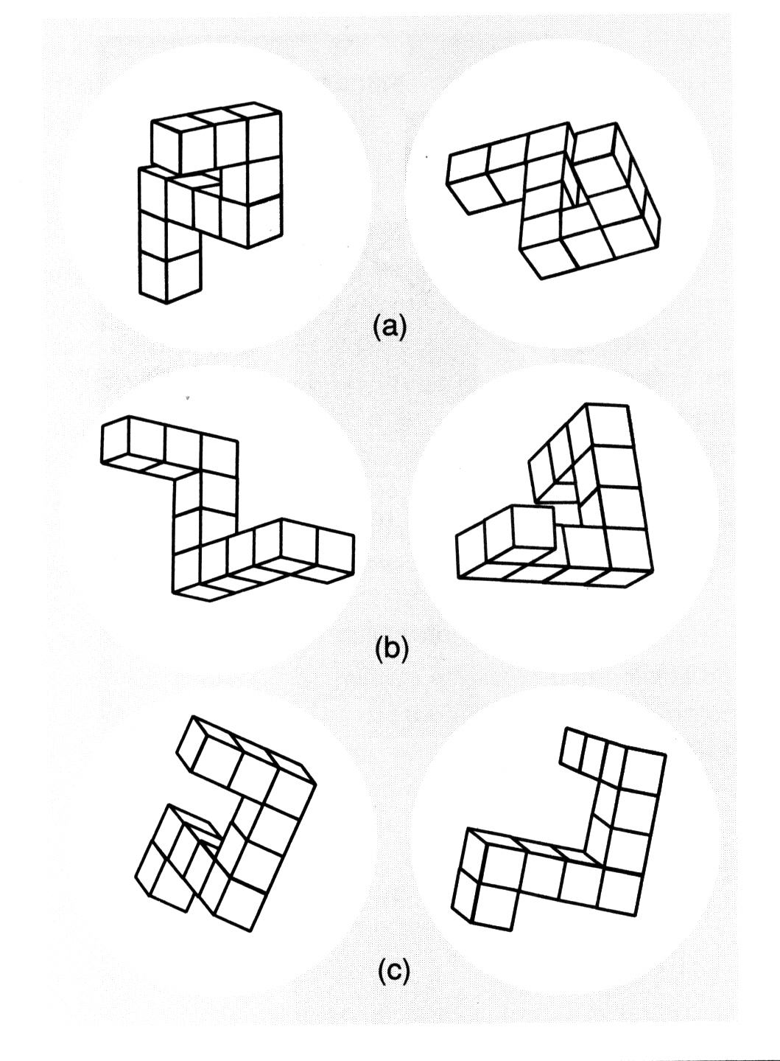

Slide 25
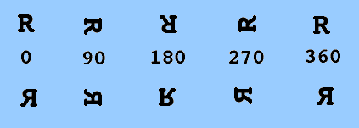
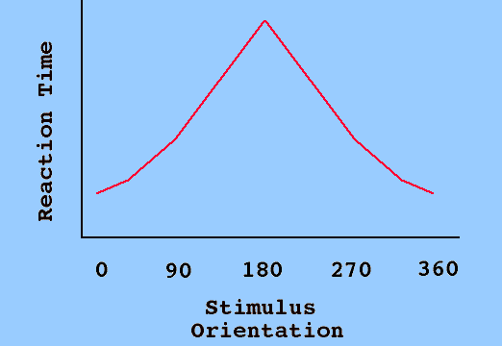
Cooper & Shephard (1973) Mental Rotation Study

Slide 26
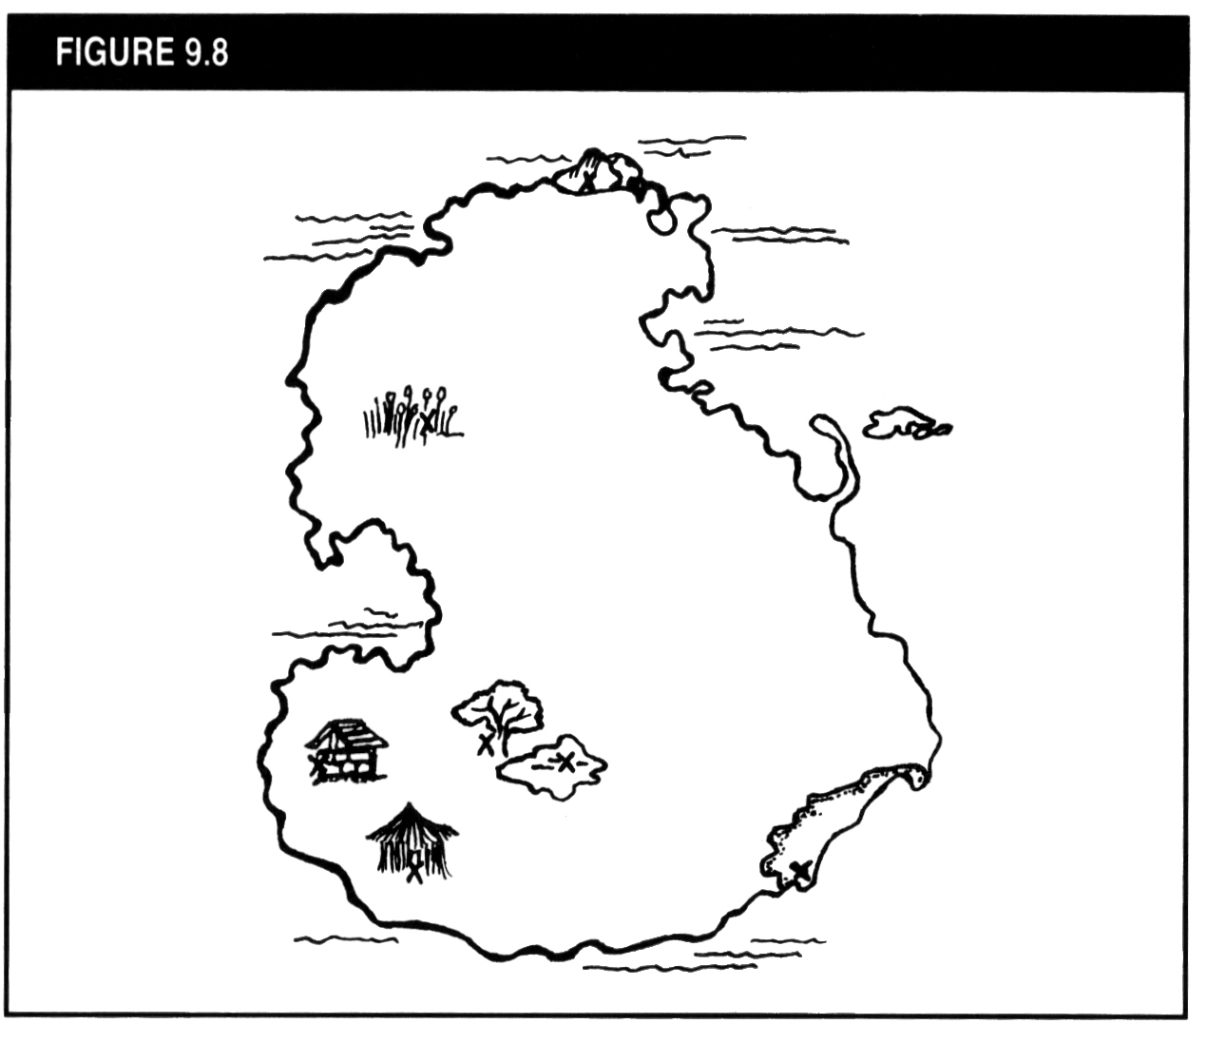

Slide 27
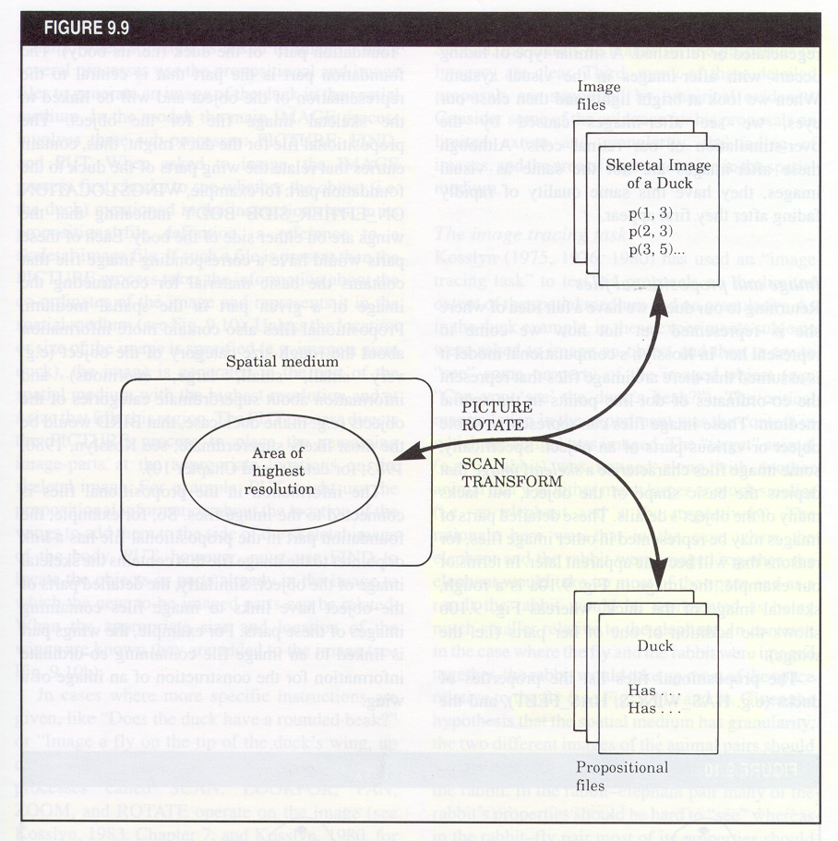
Kosslyn’s Computational Model of Imagery
IMAGE FILES
Information about how images are represented spatially
SPATIAL MEDIUM
1. Functions as a space
2. Images not at uniform resolution
3. Has a grain
4. Images fade with time
LTM
PROP’NL FILES
Information about parts of objects and how related to each other

Slide 28
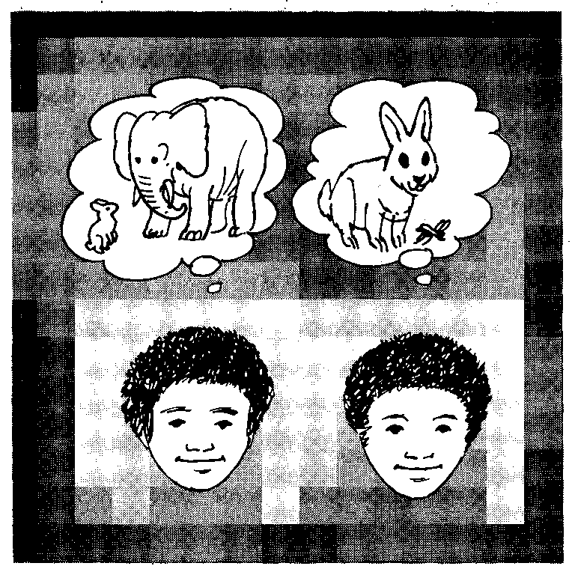
Image granularity matters
Spatial medium has granularity: RT to decide if rabbit has a visible property (e.g., claws) is faster in the right image (Kosslyn, 1980)

Slide 29
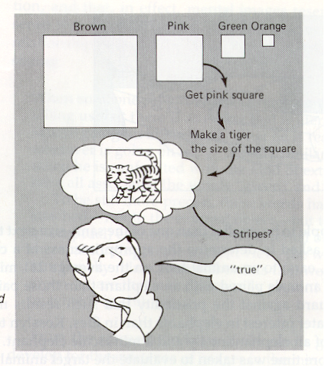
Image size matters
RT to decide if animal had an attribute was much longer in the small squares than in the large ones (Kosslyn, 1975)

Slide 30
Summary
There is increasingly evidence that people have two types of knowledge representations
Propositional
Imagery-based
How do we define similarity judgments in either case?
How do we make categories using both sources of information?

